Slide 1
Migration mapping in the districts of
Nalanda & Nawada under
Sarve Shiksha Abhiyan in Bihar
Sponsored by-
Bihar Education Project Council (BEPC)
Dept. of H.R.D, Govt. of Bihar
Presented by
Dr.Pyare Lal
Director, B.I.E.S

Slide 2
Context & Rationale
During the course of migration ,children also migrate with their families on the work-sites.
These work-sites are not closer to schools in most of the cases.
Resulted breaks in continuity of schooling of such children .
To comply the RTE act the children of migrating families to be ensured their enrolment in schools .
Having this in view BEPC assigned us to conduct the study on migration mapping in two selected districts i.e Nalanda & Nawada.

Slide 3
Objectives
To find out about the villages from where families are migrating seasonally.
To know about the details of families in the form of number and name who are migrating seasonally.
To know about the details of children in the age group 6-14 who are migrating seasonally with their families.
To know about the nature of work / job for which families are migrating seasonally.
To know about the time period when families are migrating seasonally.

Slide 4
Contd….
To investigate about the places where such families are migrating seasonally.
To study about the details of infrastructural facilities (Number of rooms, functional toilets, drinking water facilities) in nearest schools of the villages/habitations from where migration is taking place.
To know about the details of community buildings available with its full details (number of rooms, toilet and drinking water facilities) with recommendation of availability and suitability of such buildings for running seasonal hostels.

Slide 5
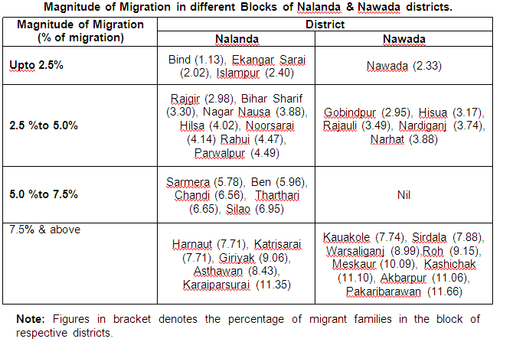
Magnitude of Migration

Slide 6
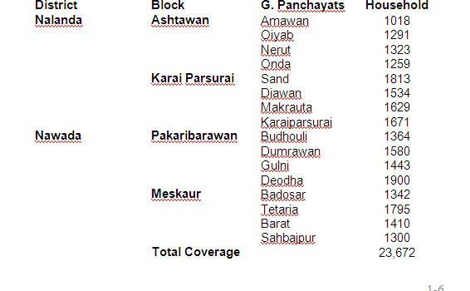
Coverage Matrix

Slide 7
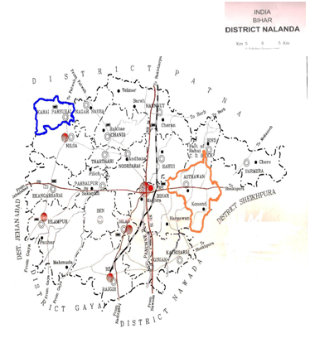
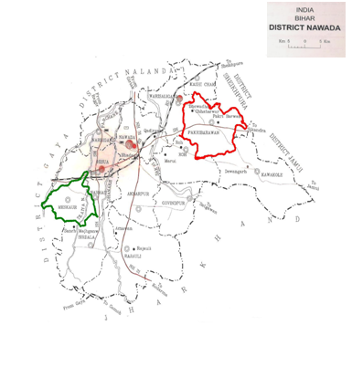
Location of Sample Blocks

Slide 8
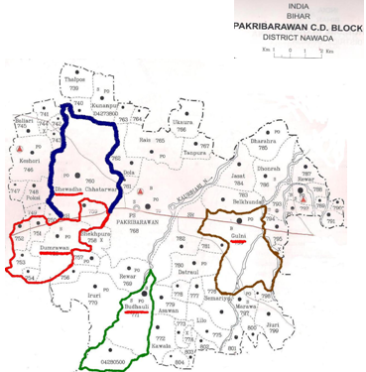
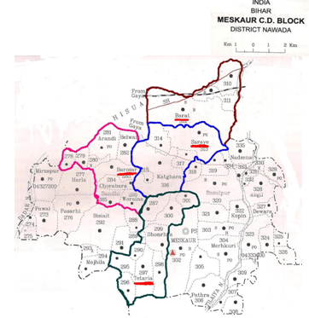
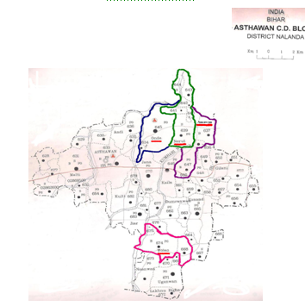
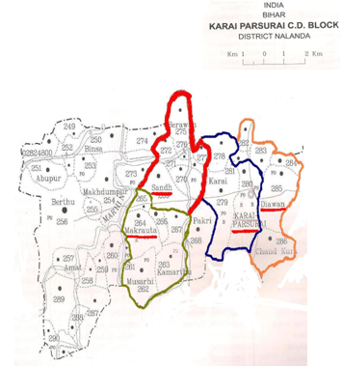
Location of G. Panchayat

Slide 9
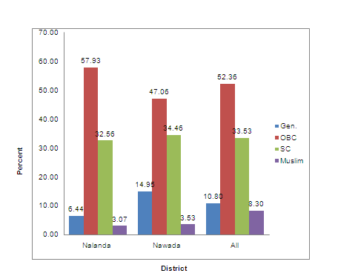
Households by their social groups( in %)

Slide 10
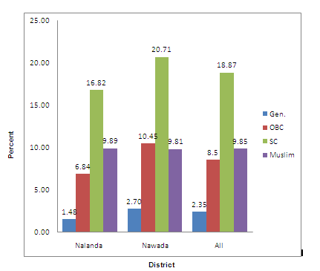
Families migrating seasonally with children( in %)

Slide 11
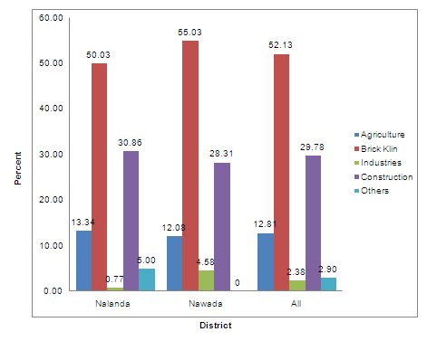
Migrant families by their nature of job during migration( in %)

Slide 12
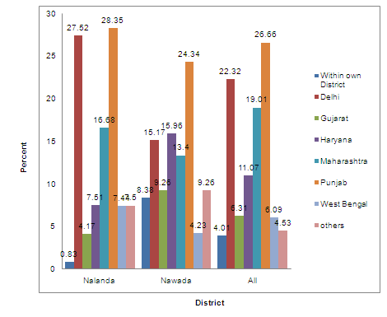
Families migrating seasonally by their place of migration(in %)

Slide 13
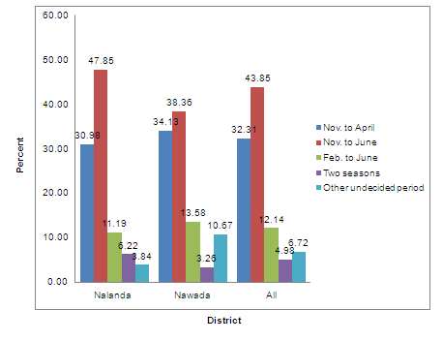
Migrant families by their period of migration(in %)

Slide 14
Other Findings: Education effected to children
Seasonal migration causes a strange kind of drop -out.
Children enrolled and attend schools only first few months.
Drop out for part of the year.
Children cooperate their families during migration.

Slide 15
Availability of infrastructure for seasonal schools/hostel for children
8 % of schools in Nawada and 12 % schools in Nalanda Districts can be used as seasonal hostel only after putting some basic infrastructure.
Community halls available in the districts but not so much specious & having no infrastructure facilities.

Slide 16
Suggestions
Seasonal hostel in villages of migration prone/work-sites.
Schools / learning center at work-sites.
Bridge courses in migration prone villages .

Slide 17
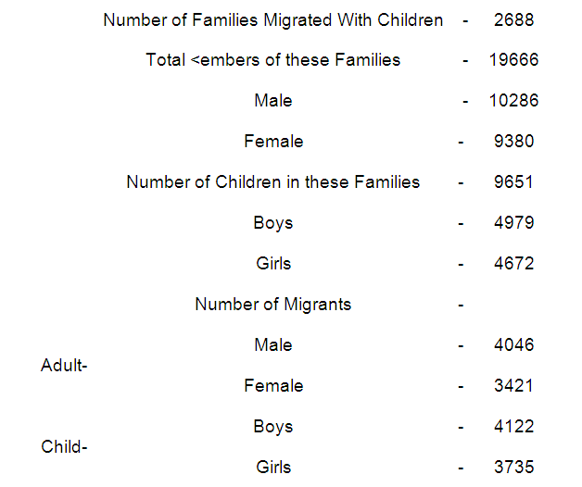
Migration at a Glance
Members

Slide 18
Thanks

